Slide 1
OPIM 628
Business Analytics
Sarah Yini Gao
yngao@smu.edu.sg

Slide 2
Kaggle Competition Grading
10% on models (novelty/rigor) + 10% on prediction performance of Milestone 1 (by the end of recess week, 3 Mar 11:59pm) + 10% on prediction performance of Milestone 2 (by the end of the competition, Mar 17, 11:59pm)
Evaluated based on a private test set
Do not overfit the public leader board!

Slide 3
Restrictions on Models
By the end of recess week, you can use only linear regression and logistic regression
Scores will be screenshotted at 3rd Mar 11:59pm
For Milestone 2, you can use linear regression, logistic regression, CART, and random forests
NO other predictive models are allowed

Slide 4
No Restrictions on Coding
You can use different packages for these techniques
You can search online for tips or tricks that make your coding more efficient
You can use any visualization techniques (no restriction) to help identify patterns and generate ideas to formulate your models

Slide 5
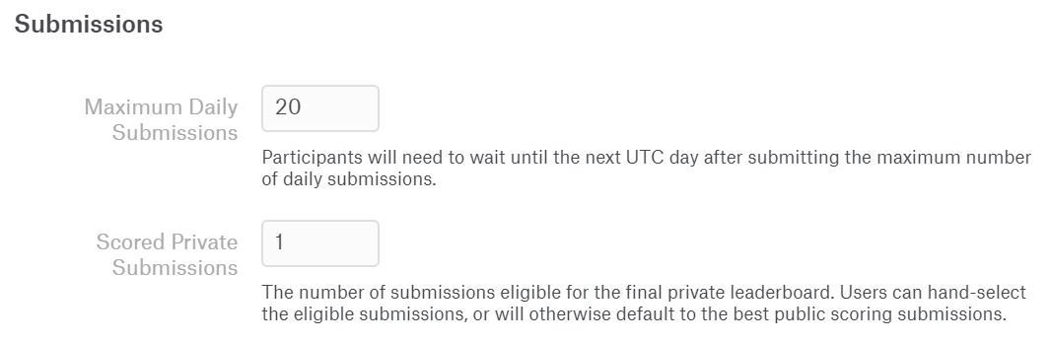
Other Rules
Each group is allowed to have only one account
Team name format: “G1 Group 1”, “G2 Group 2”
Submission under different names will not be considered
Each team can submit maximum 20 attempts every day

Slide 6
R Code
Prepare a single R Notebook file with your models and a description of your team’s approach
One file per group
Clear documentation of your models
Not necessary to include all the models you have tried
At least two models
One model for Week 8 performance checkpoint (Milestone I)
Another model for the final performance checkpoint (Milestone II)
Clearly indicated in the description
Can be compiled with training and test data sets stored in the same location

Slide 7
Presentation
Model presentation on Week 10
10 min for each team including time for Q&A
Not everyone has to speak
A few slides summarizing the ideas and steps for the models submitted for scoring
Graded together with your R Notebook file to assess the novelty of your models and the rigor in your analysis

Slide 8
Submissions and Deadlines
Predictions are to be submitted to Kaggle for performance evaluation
R Notebook file, presentation slides, and presentation video are to be submitted to eLearn before Week 10’s class
Check eLearn submission folders for exact deadlines

Slide 9
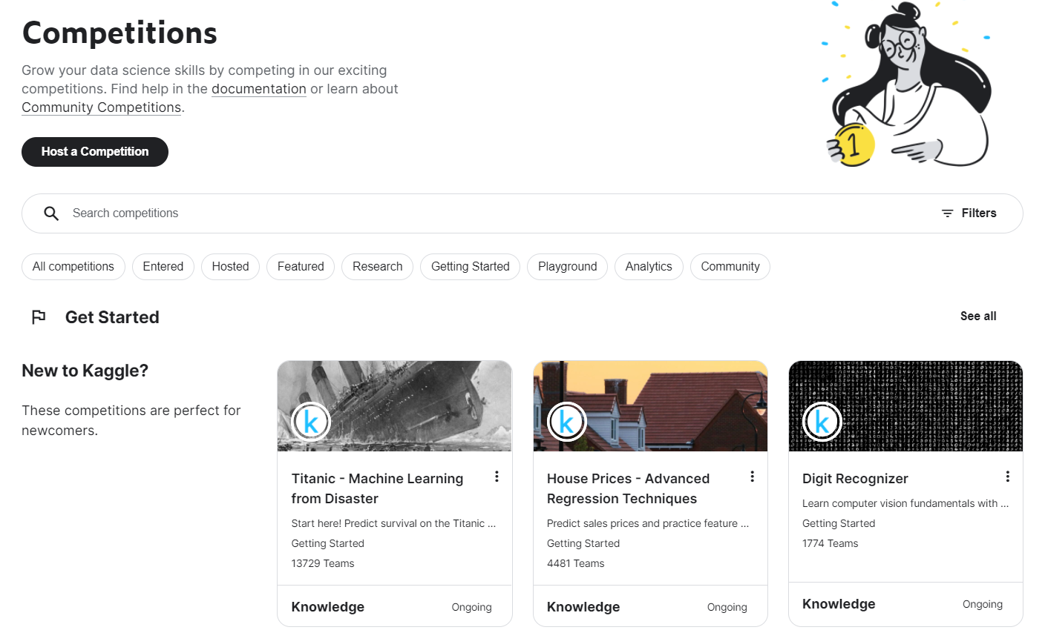
Getting Started with Kaggle
https://www.kaggle.com/competitions

